Slide 1
Arch Dental Associates
Tesseract Software Designs
Adam Franzen
Logical Presentation

Slide 2
Background / History
Arch Dental is a general dentistry practice with two locations, and a host of office personnel, and providers (hygienists and doctors)
The business is owned and operated by multiple partners who oversee operations
Sights set on expansion
Needs a robust computing system to help manage their business
Years painstakingly maintaining a paper business
Rooms and providers are not being used efficiently
No accurate tracking of clinic services offered
No ability to make reports on business financial/activity history

Slide 3
Environment
Arch has multiple locations
Each location has several rooms/spaces that can be utilized for patient services
Patients are scheduled for appointments and are given an estimated time to complete requested procedures
Procedures may be completed by hygienists or doctors

Slide 4
Users / Roles
Client
Provider
Admin

Slide 5
Users / Roles
Client
Primary Account Holder
View/edit household account info
View/cancel Appointments
View/create Payments
Services
Designate primary insurance holder
Add/edit insurance
Add/edit dependents

Slide 6
Users / Roles
Office
An office worker or provider
Create/view/update individual client account info
Create/view/update appointments
Process payments
Generate reports

Slide 7
Users / Roles
Admin
Main partners/providers of practice
Create/view/edit any screen
Create/edit office staff and providers
Create/edit clinics
Create/edit rooms
Create/edit services
Create/edit qualifications
Create/edit allowed insurance

Slide 8
Functional Requirements
Client
TODO

Slide 9
Functional Requirements
Office
TODO

Slide 10
Functional Requirements
Admin
TODO

Slide 11
Non-functional Requirements
TODO

Slide 12
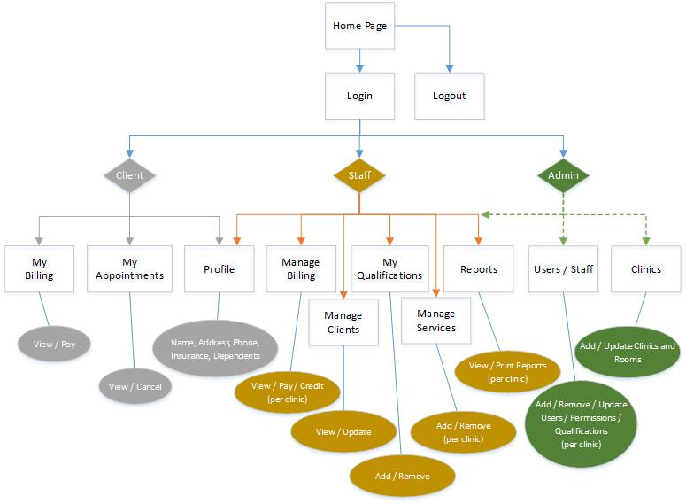
Site Diagram

Slide 13
Features and Benefits
Feature | Benefit
TODO

Slide 14
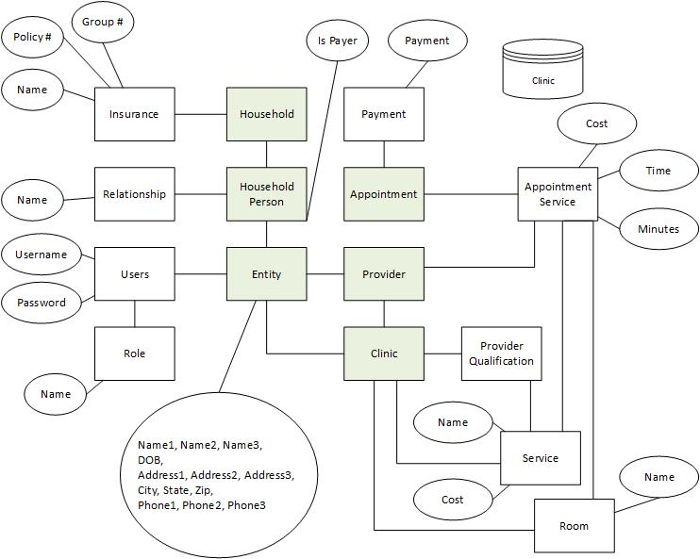
Database

Slide 15
Database
Crows foot er diagram with no attributes

Slide 16
UML
TODO

Slide 17
Use Cases
1 or 2 essential form

Slide 18
Use Cases
1 or 2 expanded form

Slide 19
Status – Last Week
Finalized database design (2.5 hours)
Research Entity Framework (4 hours)
Throwing out Entity Framework – Non-functional for .NET 4.0
Wrote requirements based upon initial requirements doc (1.5 hours)
Finalized Users/Roles (0.5 hours)
Finalized front-end framework (0.5 hours)
Single Page Application, Angular JS, Bootstrap-UI, Angular-UI, LESS, AJAX-JSON
Finalize back-end framework (0.5 hours)
Microsoft Web API
Layered approach (Controller / Business Layer / Data Layer)
Data Layer will utilize inline SQL

Slide 20
Status – This Week
Begin implementing features
Establish UI Framework and tooling
Establish back end framework layers and achieve Oracle connection
Landing Page
Logo
Login / Security
Navigation
Encryption / Decryption of passwords and Tax ID (Social Security Number)

Slide 21
Status – Challenges
Spent a lot of time struggling with Entity Framework
Couldn’t get it working despite many videos/tutorials showing it working
Research shows that Oracle doesn’t play nicely with .NET 4.0 and Entity Framework

